Slide 1
COMPUTER ORGANIZATION AND ARCHITECTURE
Dr. Rizwan Khan
Head – Department of Computer Science and Engineering
(An NBA Accredited Program)
ABES Institute of Technology, Ghaziabad

Slide 2
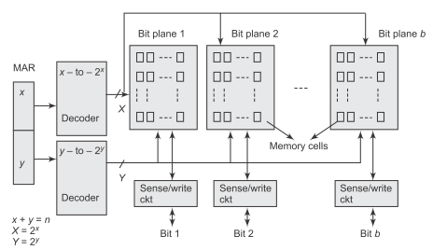
3D MEMORY ORGANIZATION

Slide 3
3D MEMORY ORGANIZATION
For an n-bit MAR in 2D organization the word lines are linearly selected and hence the number of decoder gates is 2^{n} .
By contrast, in 3D organization, the number of decoder gates reduces to 2.2^{n/2} for x = y = n/2. Such saving in the circuit cost has motivated the designers to design 3D organized memory cell array.
The n-bit address is divided into two parts having x and y number of bits. For a square array, each half is decoded and 2^{n/2} X and Y drive lines are fed into each array of bit plane.
For b-bit word memory, there are b number of planes each referring to a bit.
Corresponding to each bit plane there is a sense/write circuit. The read/write operations in 3D organization is same as to 2D with the modifications that a cell in a bit plane is selected by activating X and Y drive lines simultaneously, and bit information passed through the selected cell in a bit plane.
Thus each cell in the array needs 3 terminals – X, Y and bit line connected to sense/write circuit.
More the number of terminals (wires) through a cell, larger the cell size and consequently switching speed is less. Also, the design of the overall circuit becomes very complex.

Slide 4
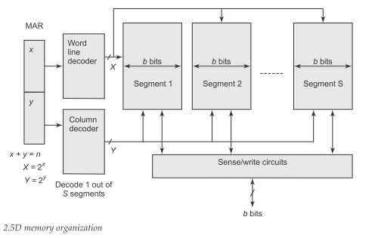
2½D MEMORY ORGANIZATION

Slide 5
2½D MEMORY ORGANIZATION
To cope up the above difficulties experienced in 3D organization, the design of 2.5D memory organization has evolved which combines the function of bit lines and Y drive lines.
In 2.5D organization there exists a segment, corresponding to bit plane of 3D organization.
The content of MAR is divided into two parts–x and y number of bits.
The number of segments S is equal to 2^{y} .
X = 2^{x} drive lines are fed into the cell array and y number of bits decode one bit line out of S lines fed into a segment of the array. In total, there are Sb number of bit lines for a b bit per word memory.
Thus for any given address in the MAR, the column decoder decodes b out of Sb bit lines by using the y bits of the MAR while a particular word line is activated by using the x bits.
Thus only the b number of bits in the array are accessed by enabling the word line and b number of bit lines simultaneously.
Though 2.5D organized memory may need lesser chip decoding logic, it suffers from one drawback. With high density chips, a simple failure, such as external pin connection opening or a failure on one bit can render the entire chip inoperative.

Slide 6


